Slide 1


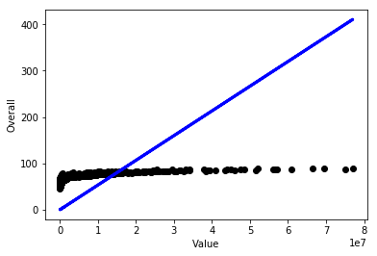
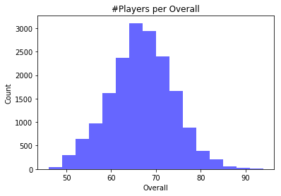
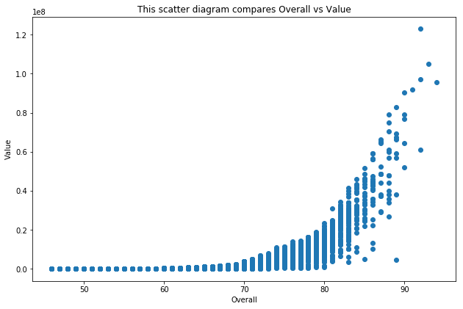
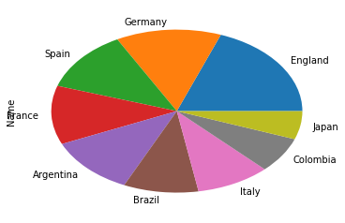
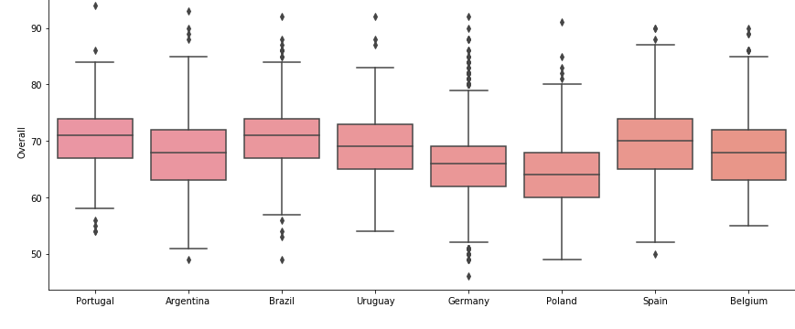
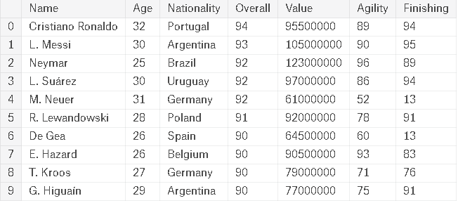
IPE-205 | Python in Industrial Engineering | Machine Learning to FIFA 18
Summary of the Poster:
We created a predictive model that is able to forecast how good a soccer player is based on their game statistics (using Python in kaggle.com).We visualize the data with histogram, pie chart, boxplot. From the scatterplot we can see that increase in value of a player increases the overall rating of the player. The Linear Regression model helps us to predict the future overall rating of the player.
Steps for the analysis:
Preparing the data
Understanding the data
Histogram
Machine learning algorithms for building our predictive model
Linear regression
Boxplot
Scatterplot
Pie chart
Linear Regression
Histogram
Scatterplot
Code
plt.hist(df.Overall, bins=16, alpha=0.6, color='b')
plt.title("#Players per Overall")
plt.xlabel("Overall")
plt.ylabel("Count")
from sklearn import linear_model
regr = linear_model.LinearRegression(fit_intercept=False)
regr.fit(xtrain, ytrain)
y_pred = regr.predict(xtest)
plt.scatter(xtest, ytest, color='black')
plt.plot(xtest, y_pred, color='blue', linewidth=3)
plt.xlabel("Value") plt.ylabel("Overall")
plt.show()
import seaborn as sns
fig = plt.figure(1, figsize=(300, 6))
ax = fig.add_subplot(111)
sns.boxplot(x=df['Nationality'],y=df['Overall'],data=df)
plt.scatter(x=df['Overall'],y=df['Value'])
players = df[["Name", "Age", "Nationality"]].dropna() players.groupby("Nationality").Name.count().sort_values(ascending=False).head(9).plot(kind="pie")
Pie chart
Boxplot
Submitted to:
Tanmoy Das
Kaggle Link:
https://www.kaggle.com/sdsourav80/poster-presentation
Github Link:
https://github.com/SdSourav/Poster-Presentation
Submitted by:
201736012
201736044
201736045
201636045
Dataset

